Slide 1
Data Foundation Systems
Data Entry Verification Workflow Node.js
Group 2 Team 1
Prashant Raj (2020201057)
Trisha Gupta (2020201086)
Avi Agarwal (2020201046)

Slide 2
Technologies Used
MySQL
Express.js
React.js
Node.js

Slide 3
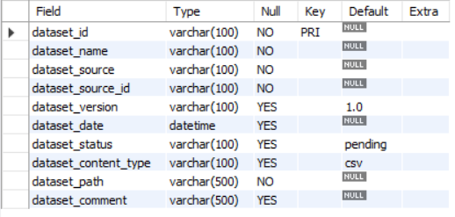
Database Schema
Universal Table - Stores metadata information of each dataset.

Slide 4

Database Schema
Employee Data table - For login authentication and to handle differential dashboard access based on whether employee is a manager or not.

Slide 5

Database Schema
Dataset Details table - To store dataset information such as path and ID used to dynamically load manager dashboard.

Slide 6
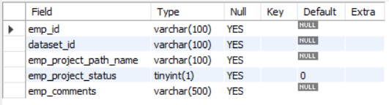
Database Schema
Employee Dataset Mapping table - To store datasets assigned to each employee. Used for dynamic display on employee dashboard.

Slide 7
Project Functionalities Implemented: Manager
Manager Dataset Dashboard - Separate tabs for datasets “To Be Verified”, “In Process”, “Processed”.
To Be Verified: Datasets that have not been assigned to employees.
In Process: Datasets that have been assigned to employees but have not yet been verified.
Processed: Datasets that have been verified (accepted/rejected).
Dataset Info pages - Houses metadata information about the dataset.
A functionality to verify source if the last verification was more than a week old.
A functionality to divide the dataset amongst all available employees with employees listed in decreasing order of availability based on verification workload.
A functionality to add comments to send back to the source of dataset.

Slide 8
Project Functionalities Implemented: Employee
Employee Dataset Dashboard - Separate tabs for datasets “To Be Verified”, “Verified”.
To Be Verified: Datasets that have been assigned to the particular employee for verifying.
Processed: Datasets that have been verified (accepted) by the employee.
Dataset Info pages - Displays the file location of assigned dataset to the employee.
A functionality for one click verification of dataset.
A functionality to add comments to send to the manager.

Slide 9
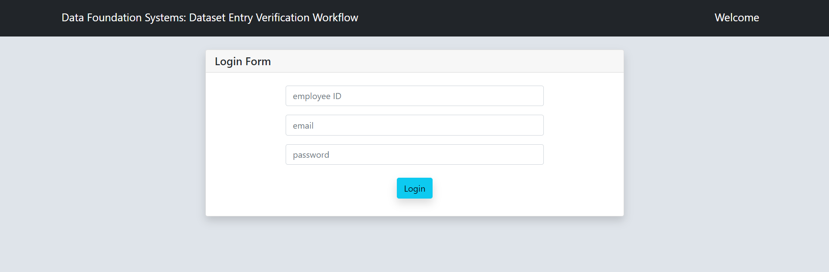
Screenshots: Login

Slide 10
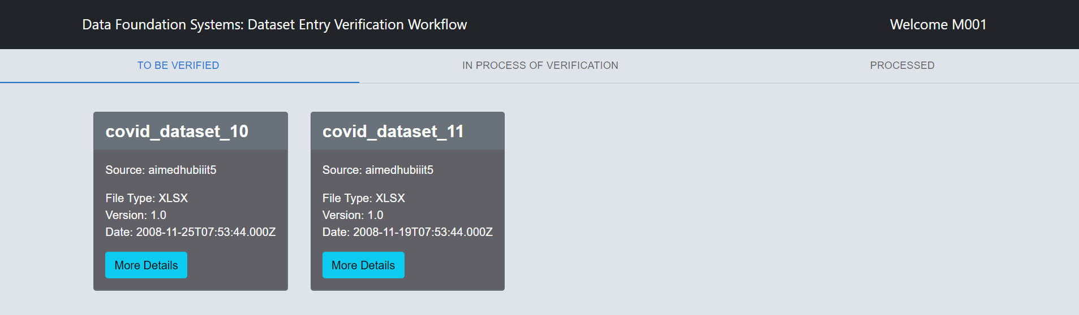
Screenshots: Manager Dashboard

Slide 11
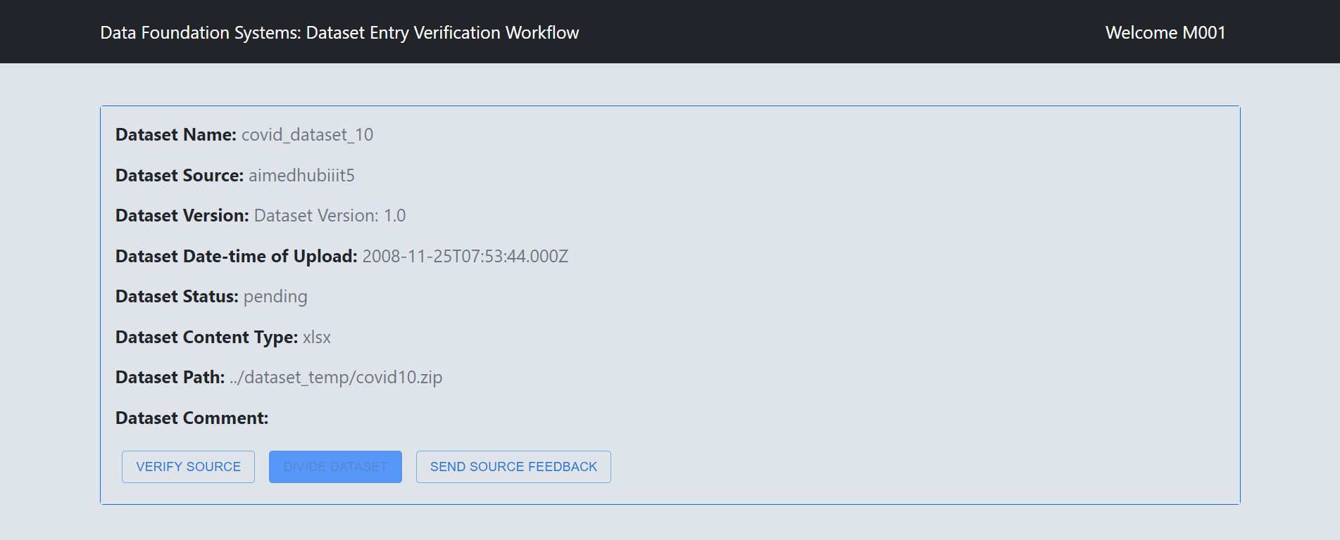
Screenshots: Manager Dataset Details

Slide 12
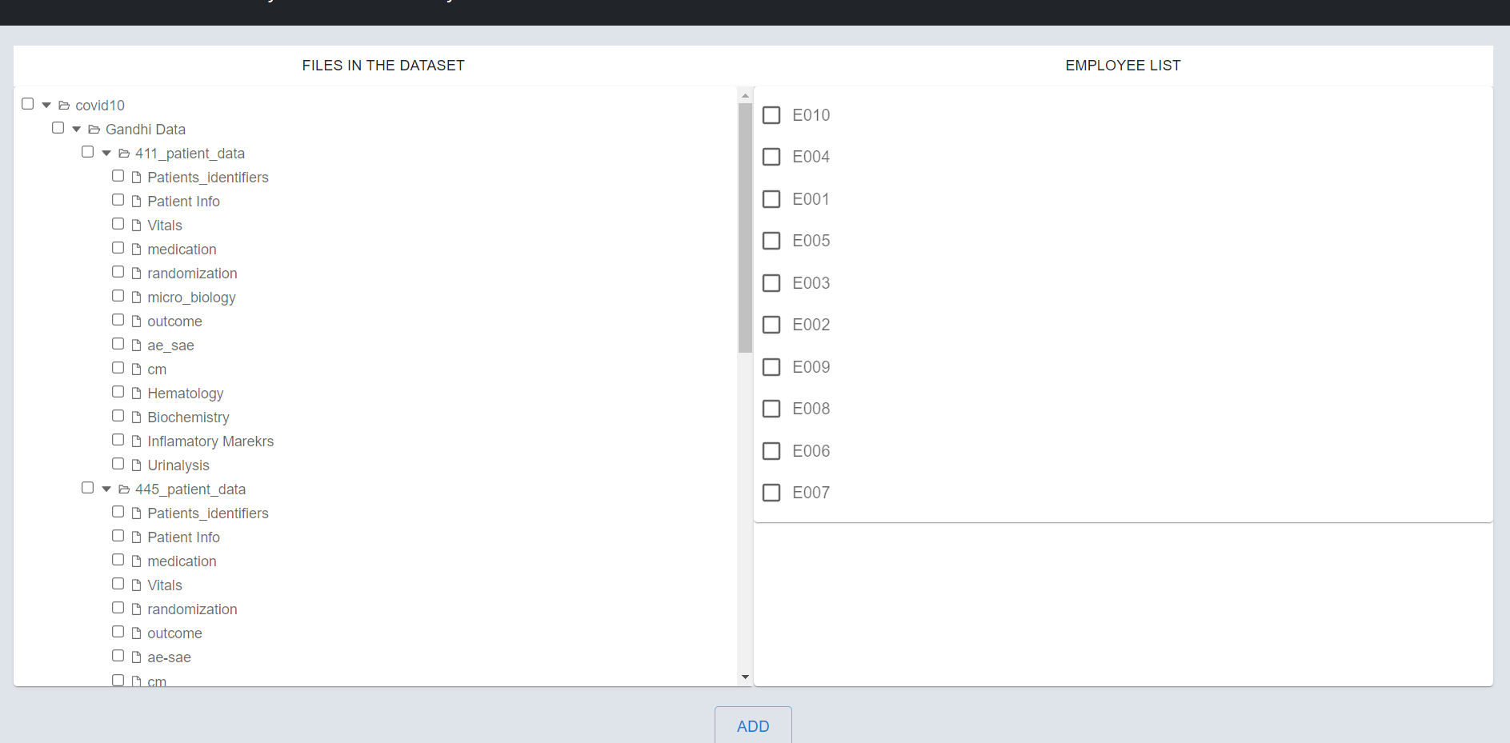
Screenshots: Divide Dataset

Slide 13
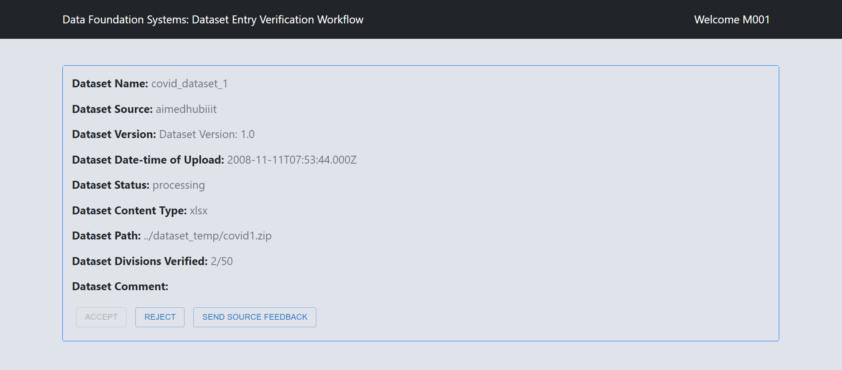
Screenshots: Manager Dashboard - Processing Dataset Details

Slide 14
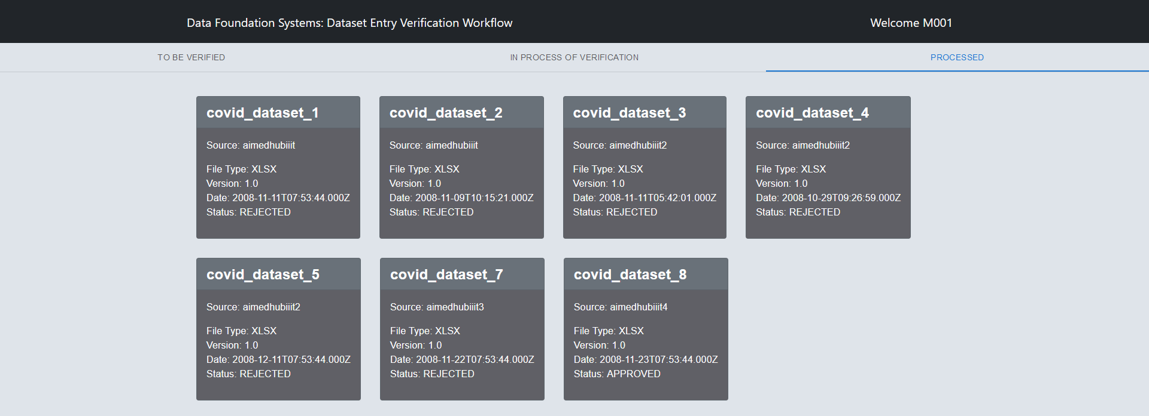
Screenshots: Manager Dashboard - Processed

Slide 15
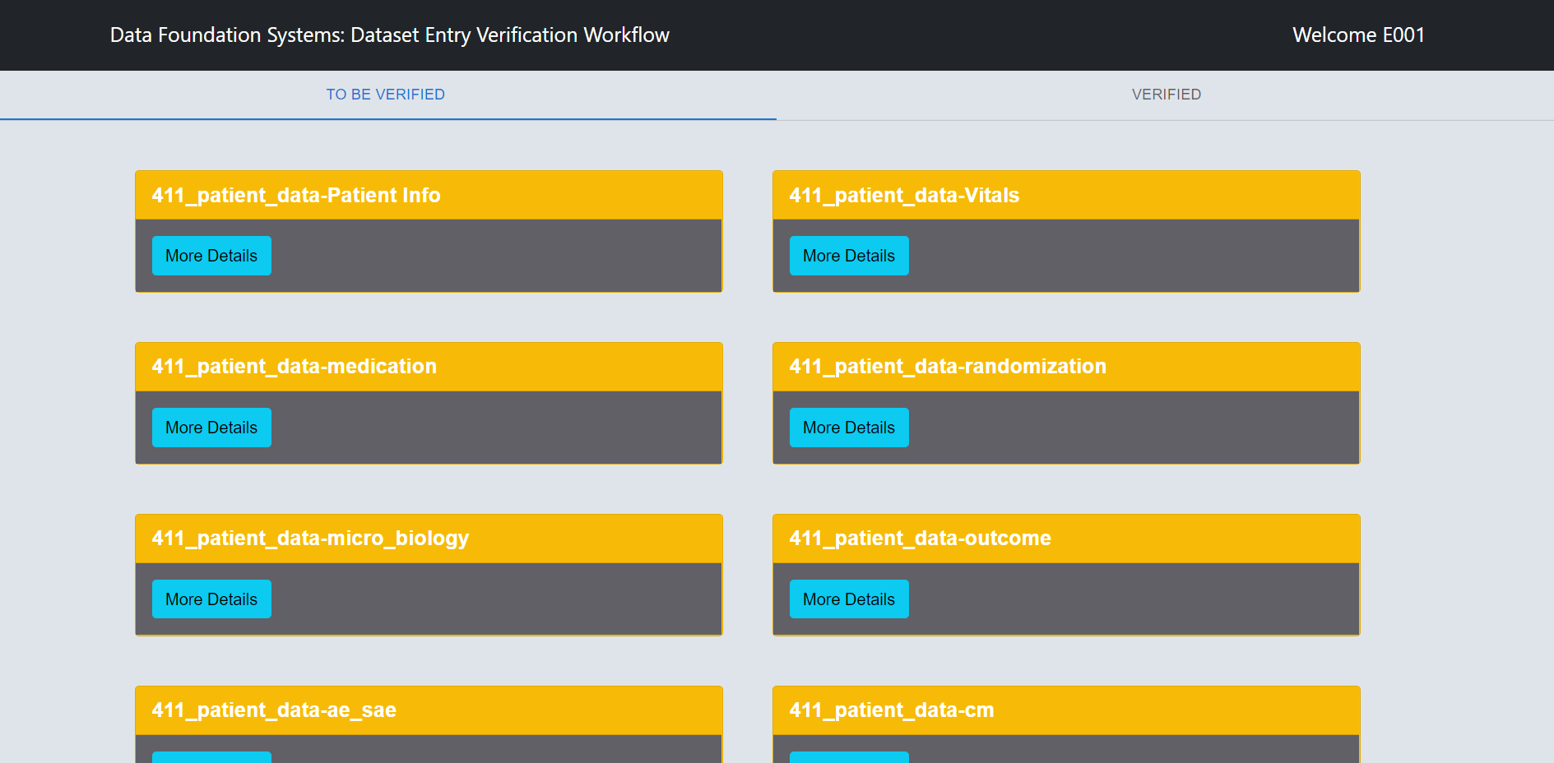
Screenshots: Employee Dashboard

Slide 16
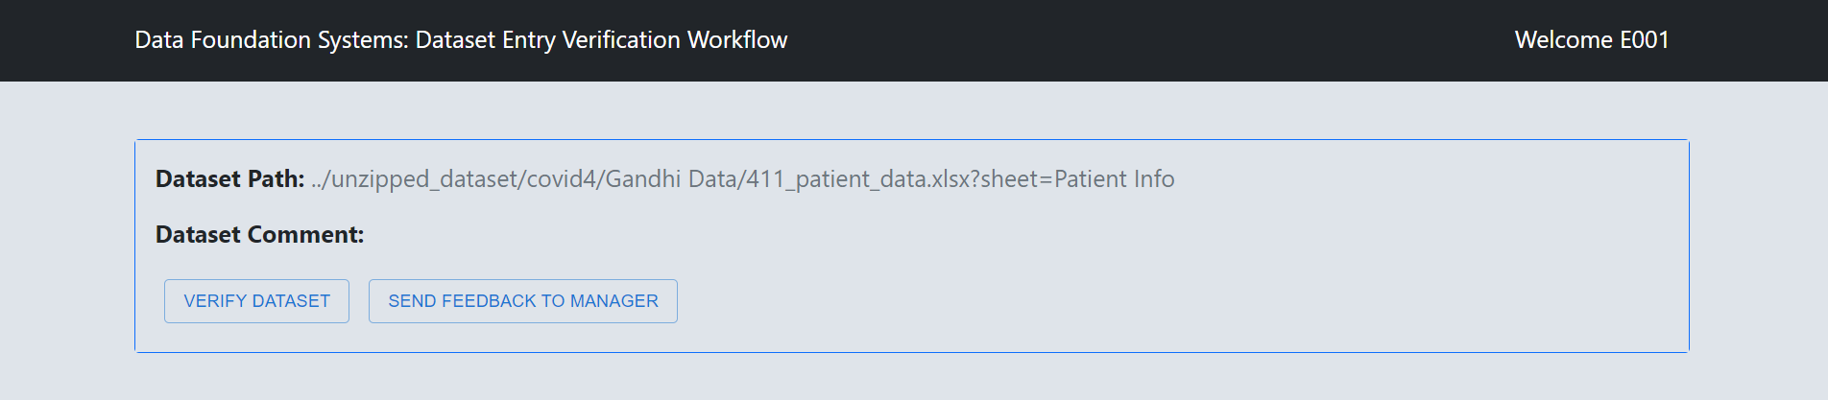
Screenshots: Employee Dataset Details

Slide 17
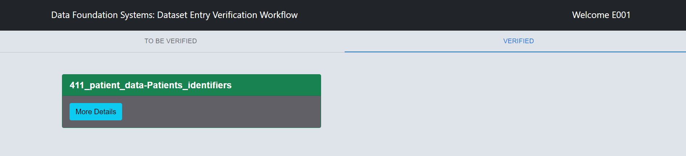
Screenshots: Employee Dashboard - Verified

Slide 18
Individual Contribution
Prashant Raj
Login Page UI structure.
Dataset Info page UI structure.
Divide Dataset page UI structure.
Backend migration to MySQL from MongoDB.
Backend code to handle unzipping and extraction of files into relevant folders.
Backend code to populate MySQL tables with extracted file records for every new dataset.
React frontend integration with node backend through API calls.
Divide Dataset priority based employee display.
Manager Dashboard changing status from processing to processed based on database entry.

Slide 19
Individual Contribution
Avi Agarwal
UI.
Material-UI.
Frontend tweaks and testing.
Bootstrap Handling
Manager Dashboards styling
Employee Dashboard
Routing structure for web pages

Slide 20
Individual Contribution
Trisha Gupta
Manager Dashboard page UI structure and functionality.
Dataset Info page functionality.
Dividing Dataset functionality.
Adding comments functionality in the dataset info page.
Verifying Source functionality in the dataset info page.
Handling MySQL calls for source verification, comment updating and employee-dataset mapping.
Login authentication based on database table data.
Employee Dashboard display and verification, comments functionality.

